Slide 1
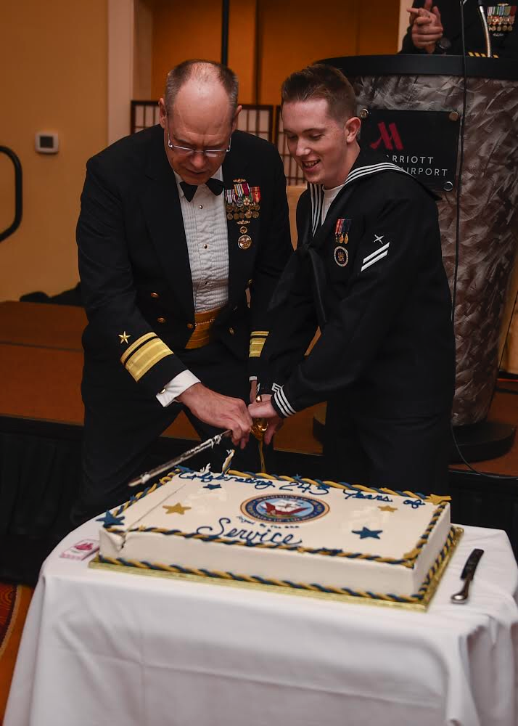
About Me…
Former Government Contractor
U.S. Military Reservist (USN)
Built/Exited a Digital Firm
Open-Source Contributor
Career of DevOps/SWE
Active Volunteer FF/EMT
Connect with me!
https://github.com/zackbradys
https://linkedin.com/io/zackbradys

